Slide 1

Logistic Regression Supervised Machine Learning
MACHINE LEARNING EXPERT

Slide 2
Course Topics
What is Logistic Regression?
How Logistic Regression works?
Logistic Regression Assumptions
Pros and Cons of Logistic Regression
Applications of Logistic Regression
Modeling Logistic Regression with Python
Optimizing Logistic Regression model performance
MACHINE LEARNING EXPERT

Slide 3
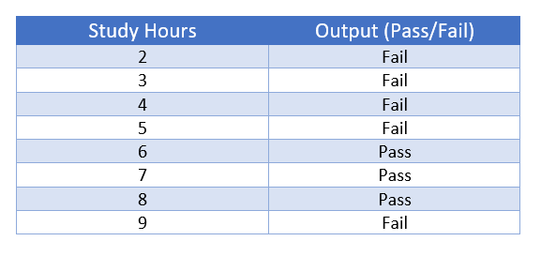
What is Logistic Regression?
Logistic Regression is a Supervised Machine Learning
Which is use for classification algorithm.
It is used to predict the probability of a categorical dependent variable.
The dependent variable is a binary variable that contains data coded as 1 (yes/true..) or 0 (No/false..).
MACHINE LEARNING EXPERT

Slide 4
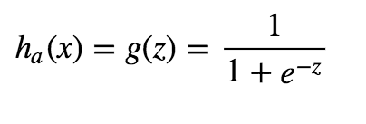
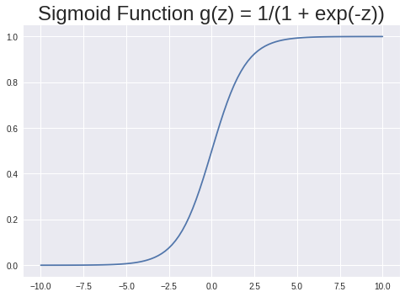
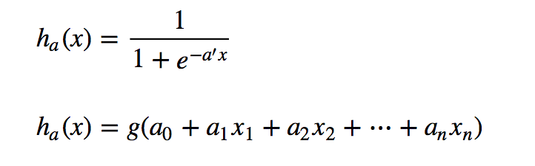
How Logistic Regression works?
Decision Boundaries
If h_{a}(x) >= 0.5 then we say y = 1
If h_{a}(x) < 0.5 then we say y = 0
MACHINE LEARNING EXPERT

Slide 5
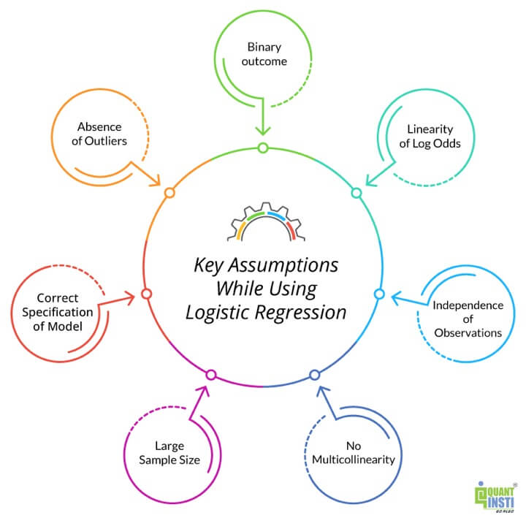
Assumptions of Logistic Regression
Binary Outcomes
Large sample size
No Multicollinearity
Absence of outliers
MACHINE LEARNING EXPERT

Slide 6
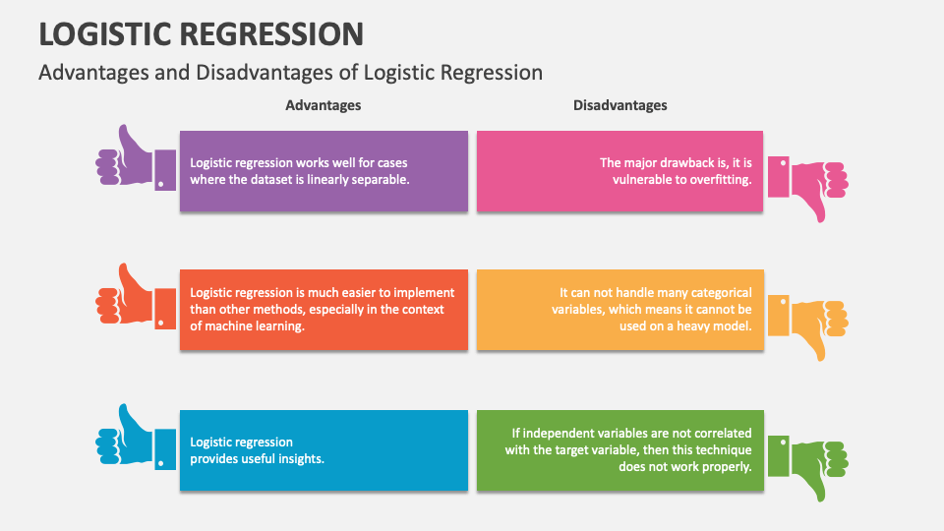
Pros of Logistic Regression
MACHINE LEARNING EXPERT

Slide 7
Cons of Logistic Regression
MACHINE LEARNING EXPERT

Slide 8


Applications of Logistic Regression
Image Segmentation and Categorization
Handwriting recognition
Spam filtering -- spam or not spam
Cell image -- cancer or normal
Production line part scan -- good or defective
MACHINE LEARNING EXPERT

Slide 9
Modeling Logistic Regression
Modeling with Python
(attached in resource section of this module)
MACHINE LEARNING EXPERT

Slide 10
Questions?
Q&A Session
MACHINE LEARNING EXPERT

